Slide 1



Slide 2
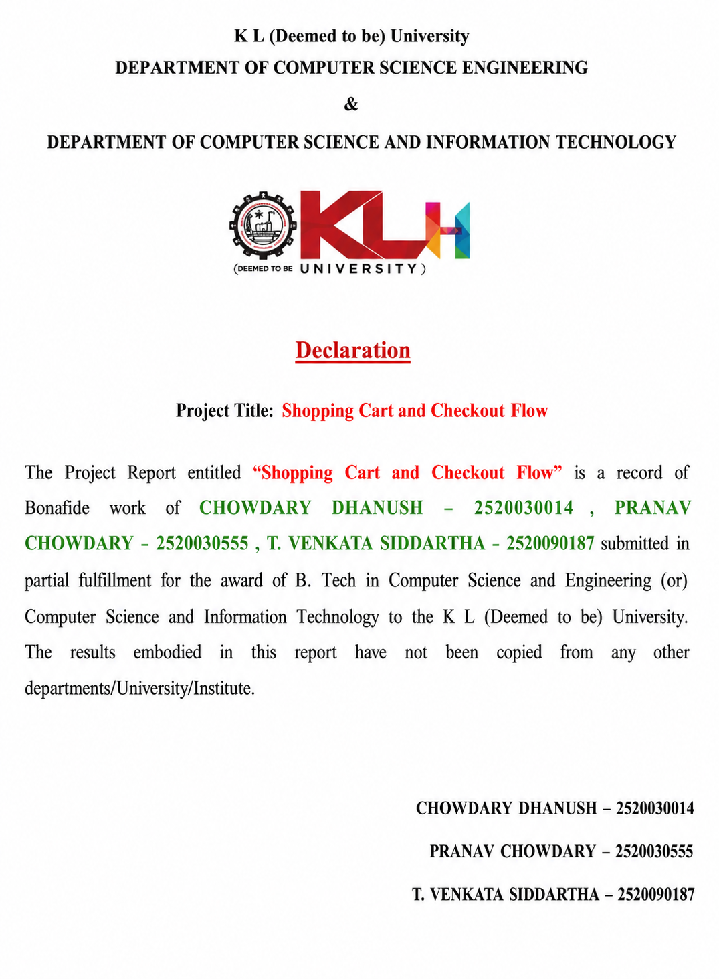

Slide 3
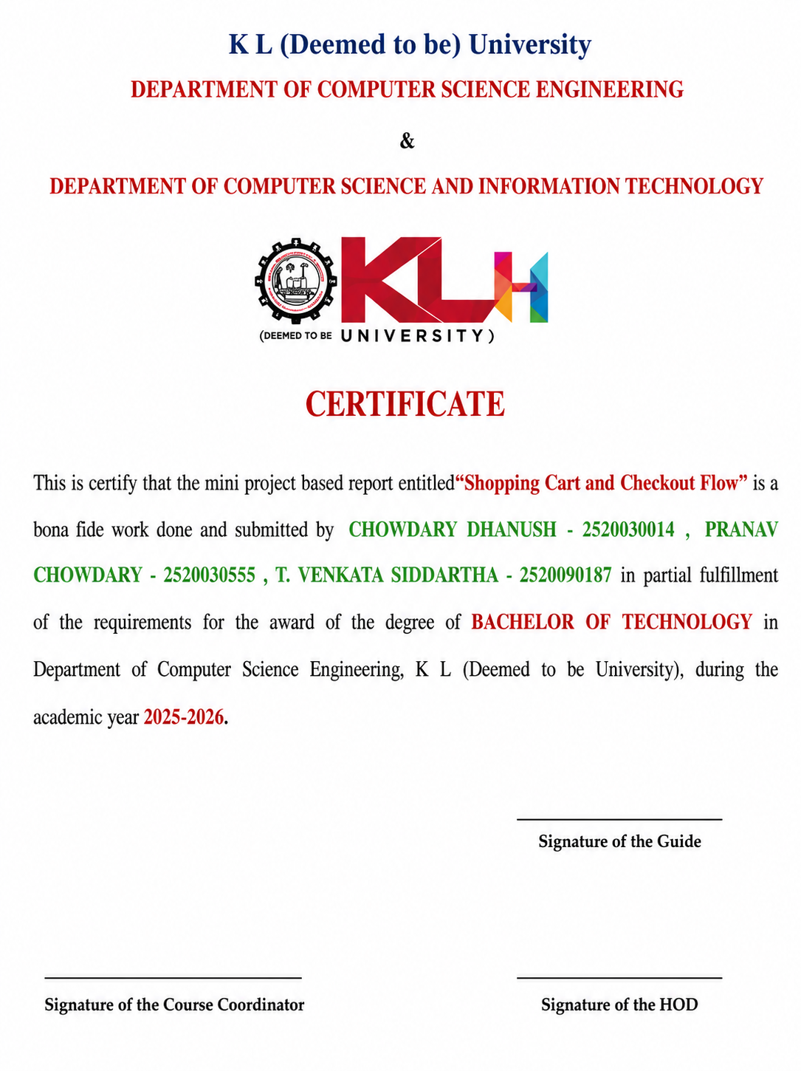

Slide 4
Acknowledgment
We express our sincere gratitude to KL University management, faculty members, and our guide for their constant support and encouragement.
We would like to convey our heartfelt thanks to our project guide and faculty members for their valuable guidance, continuous support, and constructive suggestions throughout the development of the project.
We are also grateful to the Department of Computer Science and Engineering for giving us the opportunity to work on the Hospital Bed Management System, which has enhanced our technical knowledge and practical skills.
We extend our sincere appreciation to our friends and classmates for their cooperation, encouragement, and helpful suggestions during the various stages of this project.
Finally, we express our deepest gratitude to our parents and family members for their constant motivation, encouragement, and unwavering support, which helped us successfully complete this project.
We take this opportunity to thank everyone who direc
tly or indirectly contributed to the successful completion of our project.
2520030014 2520030555 2520090187
Dhanush Pranav siddartha

Slide 5
Abstract
This project is a solid implementation of a multi-step Shopping Cart and Checkout Flow in the React and Node.js ecosystem. The system uses Context API to hold the global state and allows data persistence across a 10-module journey involving dynamic cart updates, validated address forms, and a back end driven coupon engine. The architecture is built to deliver a smooth user experience, with tight data synchronization from product selection to the final order confirmation. The back end is built using Express.js, which enables the centralization of important logic, such as price calculations and discount validation, to prevent client-side manipulation and to maintain financial integrity. The system uses Axios for API calls and LocalStorage for session persistence, and provides an overview of the order lifecycle. This project is a scalable template for modern high-stakes transactional workflows.

Slide 6
CHAPTER 1: INTRODUCTION
Online shopping has become an essential part of modern life due to the rapid growth of the internet and e-commerce. Customers expect a simple, secure, and fast shopping experience while purchasing products online. A well-designed shopping cart and checkout system plays a major role in improving customer satisfaction by allowing users to add products, manage quantities, apply discounts, and complete payments easily.
The Shopping Cart and Checkout Flow project is a web-based application developed using modern frontend technologies. It provides a smooth shopping experience by enabling users to browse products, add or remove items from the cart, update quantities, view the total price, and proceed through a multi-step checkout process. The application focuses on creating an attractive, responsive, and user-friendly interface.
This project demonstrates the implementation of state management, reusable UI components, form validation, local storage, and responsive web design. It also provides a foundation for integrating payment gateways and backend services in future enhancements.

Slide 7
The application is developed using modern frontend technologies such as React.js, HTML5, CSS3, and JavaScript, providing a responsive, interactive, and visually appealing user interface. State management and local storage ensure that cart information is maintained efficiently, offering users a seamless shopping experience across different devices.
The project emphasizes user convenience, intelligent shopping assistance, improved decision-making, and faster checkout. By combining innovative features with a modern interface, SmartCart provides a smarter, more efficient, and customer-friendly online shopping platform.
This project demonstrates the practical application of modern web development concepts, reusable UI components, responsive design principles, client-side state management, and interactive user interfaces. It also lays the foundation for future enhancements such as secure payment gateway integration, AI-based product recommendations, inventory management, user authentication, and personalized shopping analytics.

Slide 8
Overall, SmartCart – Shopping Cart and Checkout Flow aims to redefine the online shopping experience by making it more intelligent, efficient, user-centric, and enjoyable. It not only simplifies the purchasing process but also empowers users to make informed buying decisions while enjoying a secure and seamless shopping journey.

Slide 9
CHAPTER 2: PROBLEM DESCRIPTION
The rapid growth of online shopping has increased the demand for efficient and user-friendly e-commerce applications. One of the most important components of an online shopping platform is the Shopping Cart and Checkout Flow. Customers expect a fast, secure, and seamless shopping experience while browsing products, adding them to the cart, and completing purchases. However, many existing systems have complicated interfaces, slow checkout processes, and poor user experiences, leading to customer dissatisfaction and cart abandonment.
The Shopping Cart and Checkout Flow project is designed to address these challenges by providing a simple, responsive, and interactive shopping experience. It focuses on making the purchasing process easier and more efficient for users.

Slide 10
2.2 Key Problems Addressed
Lack of budget management while shopping.
No price protection after adding items to the cart.
Difficulty comparing products from different brands.
No collaborative shopping for families or groups.
Poor wishlist organization.
Lengthy checkout process.
Limited order tracking.
Lack of personalized shopping assistance.
High cart abandonment rate.
Poor mobile shopping experience.

Slide 11
2.3 Advantages of the Proposed Features
Smarter shopping with budget management.
Protection against price fluctuations.
Better purchase decisions through product comparison.
Family-friendly wishlist sharing.
Real-time order tracking.
Faster and more secure checkout.
Attractive and responsive user interface.
Improved customer satisfaction and reduced cart abandonment.

Slide 12
CHAPTER 3: SYSTEM FEATURES
Features
AI-powered shopping interface.
Product browsing.
Flash deals section.
Smart Buy recommendations.
Product comparison option.
One-click checkout option.
Responsive navigation bar.
User Login and Registration.
Dark/Light mode support.
Benefits
Easy navigation.
Fast product access.
Better user experience.
Attractive UI.

Slide 13
3.2 Shopping Cart Module
Smart Budget Cart
Users can set a shopping budget.
Helps control unnecessary spending.
Displays budget usage.
Group Purchase Cart
Allows multiple users to purchase together.
Generates a shared group cart.
Useful for family and friends.
Price Lock Feature
Locks product prices for 24 hours.
Prevents price changes after adding products.
Gives customers confidence while shopping.

Slide 14
Cart Health Score
Calculates the shopping cart quality.
Displays shopping score.
Encourages users to complete purchases.
Recently Viewed Products
Shows recently viewed items.
Helps users quickly revisit products.
Cart Timeline
Displays product addition timeline.
Shows cart activity history.

Slide 15
3.3 Wishlist Module
Features
Save favorite products.
Family Wishlist support.
Multiple wishlist profiles.
Multi-user sharing.
Add family members.
Browse saved products later.
Benefits
Easy product management.
Family shopping support.
Personalized shopping experience

Slide 16
CHAPTER 4: MODULES IMPLEMENTED
The SmartCart – Shopping Cart and Checkout Flow project is divided into several functional modules. Each module is designed to perform a specific task, making the application organized, scalable, and user-friendly. The following sections describe the implemented modules.

Slide 17
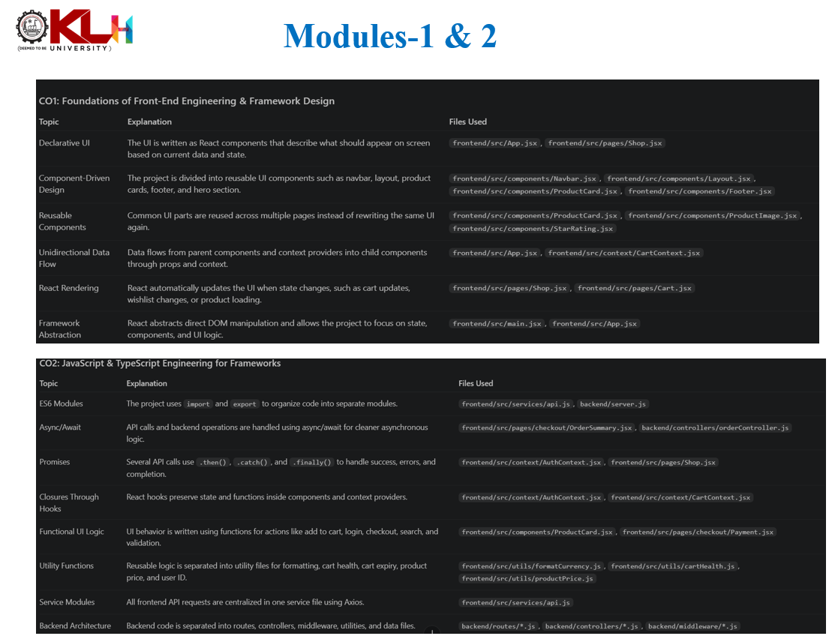

Slide 18
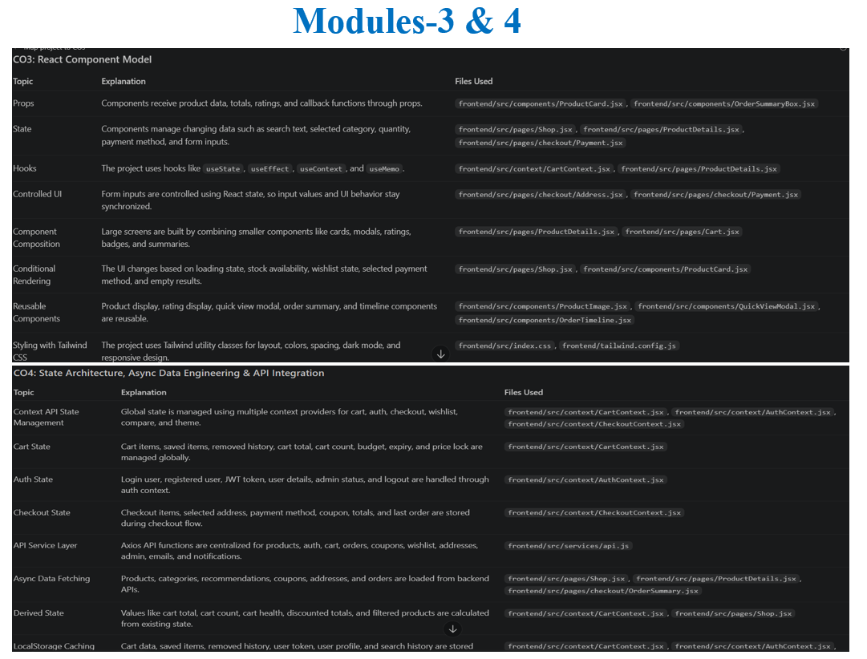

Slide 19
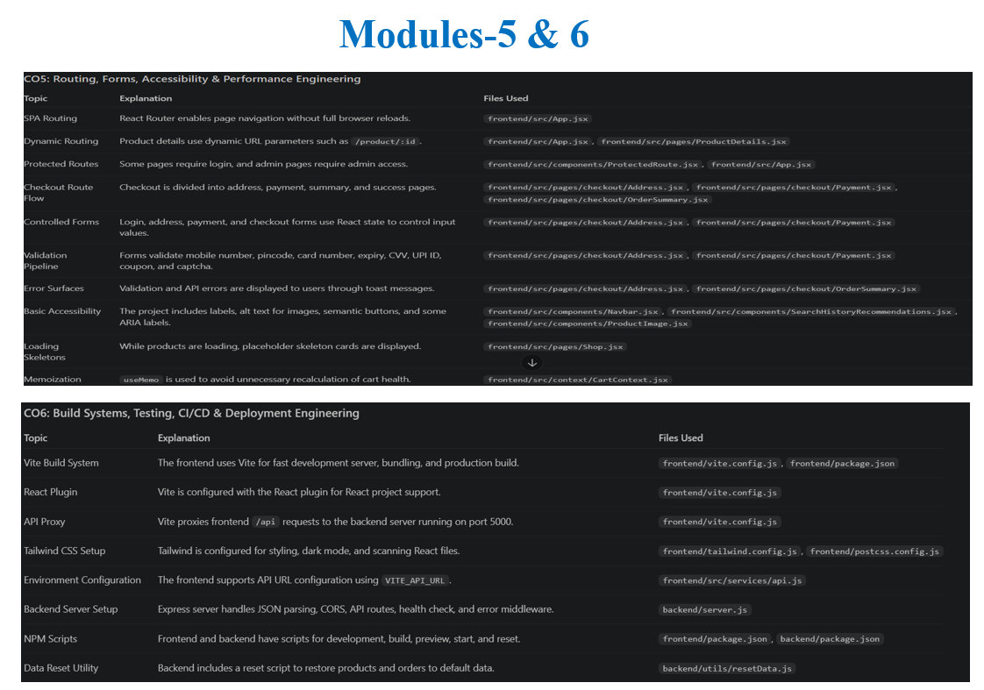

Slide 20
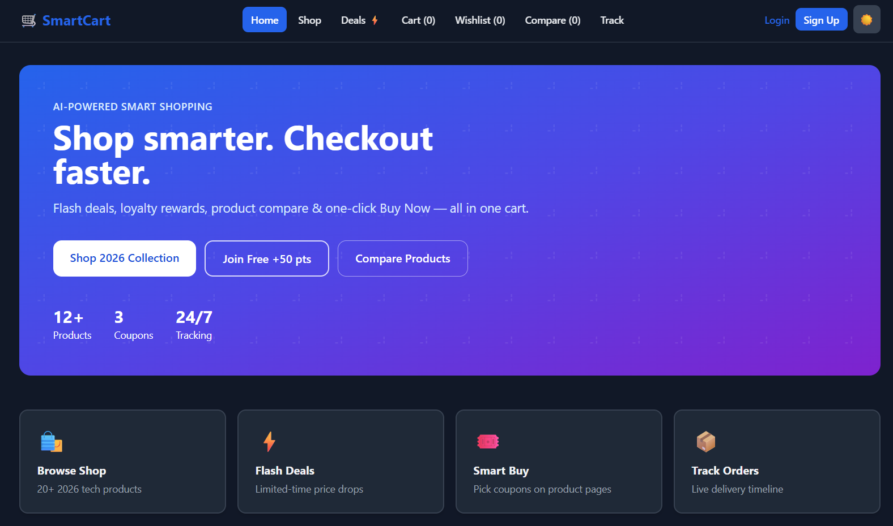
CHAPTER 5: OUTPUT AND INTERFACE

Slide 21
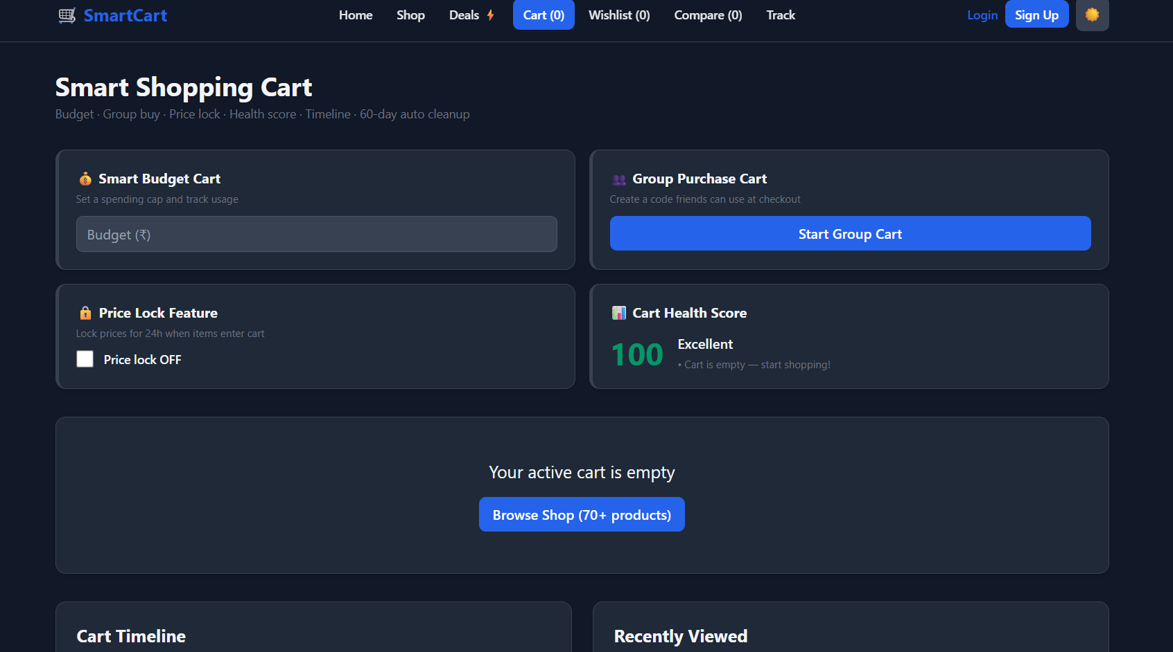

Slide 22
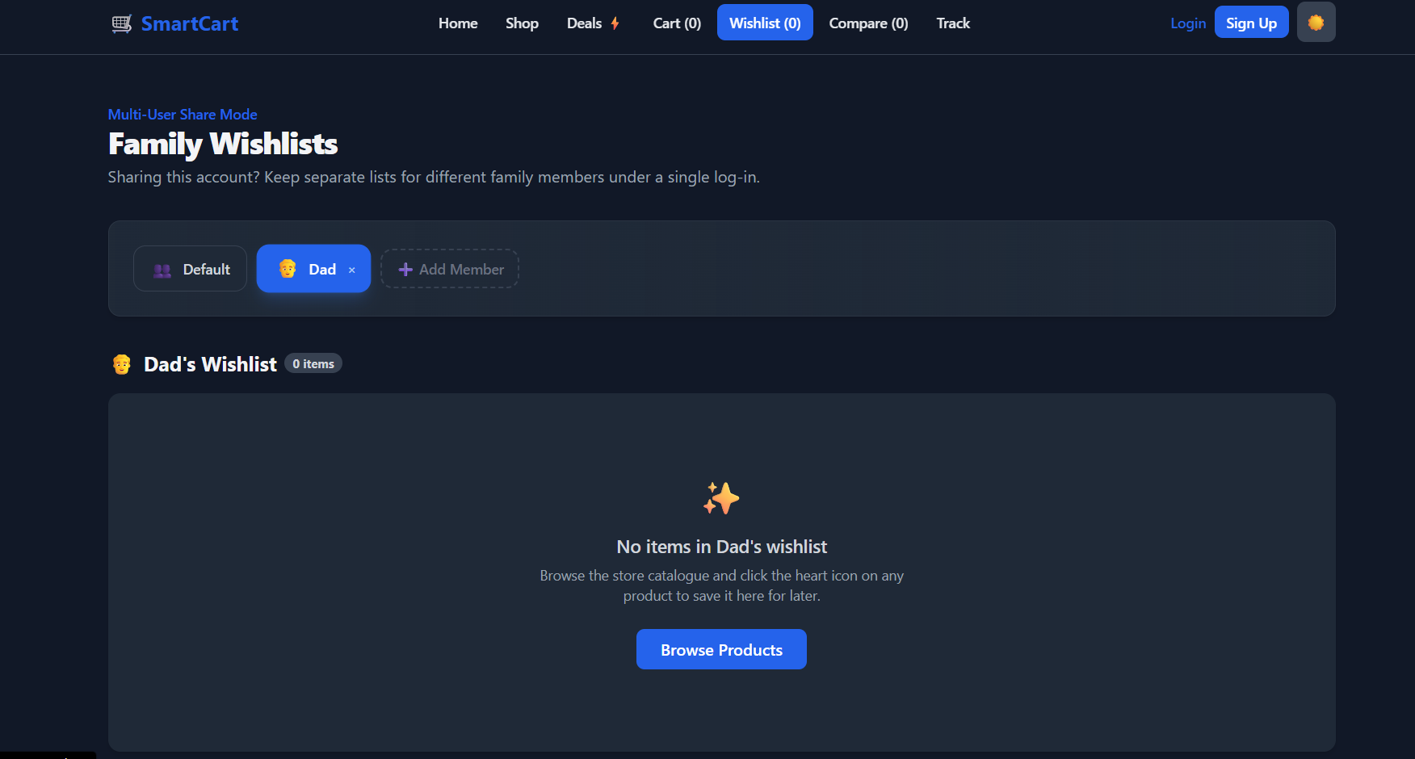

Slide 23
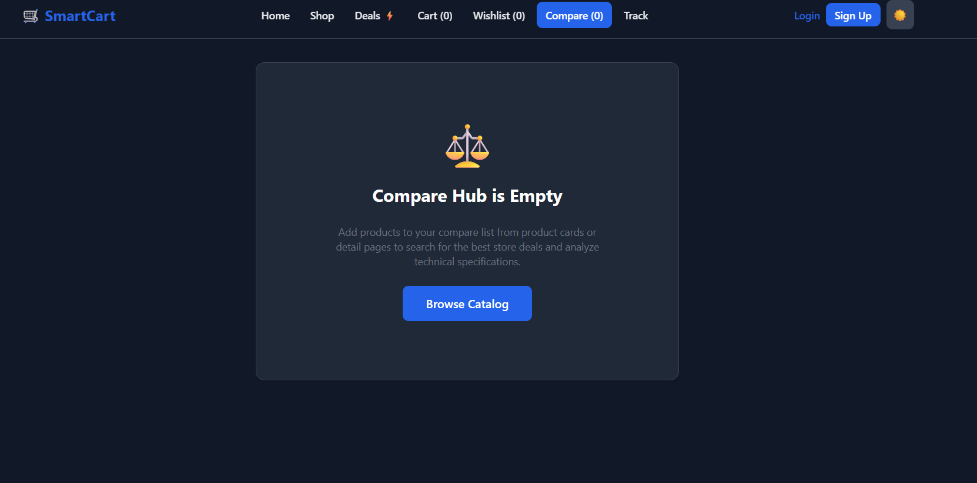

Slide 24
CHAPTER 6: SYSTEM ARCHITECTURE
The System Architecture of the SmartCart application illustrates how different components of the system communicate to provide a seamless shopping experience. The architecture follows a modular design, where each module performs a specific task and interacts with other modules through well-defined interfaces. The frontend is developed using React.js, while data is managed using Local Storage (or a backend database if integrated). This modular architecture improves scalability, maintainability, and user experience.

Slide 25
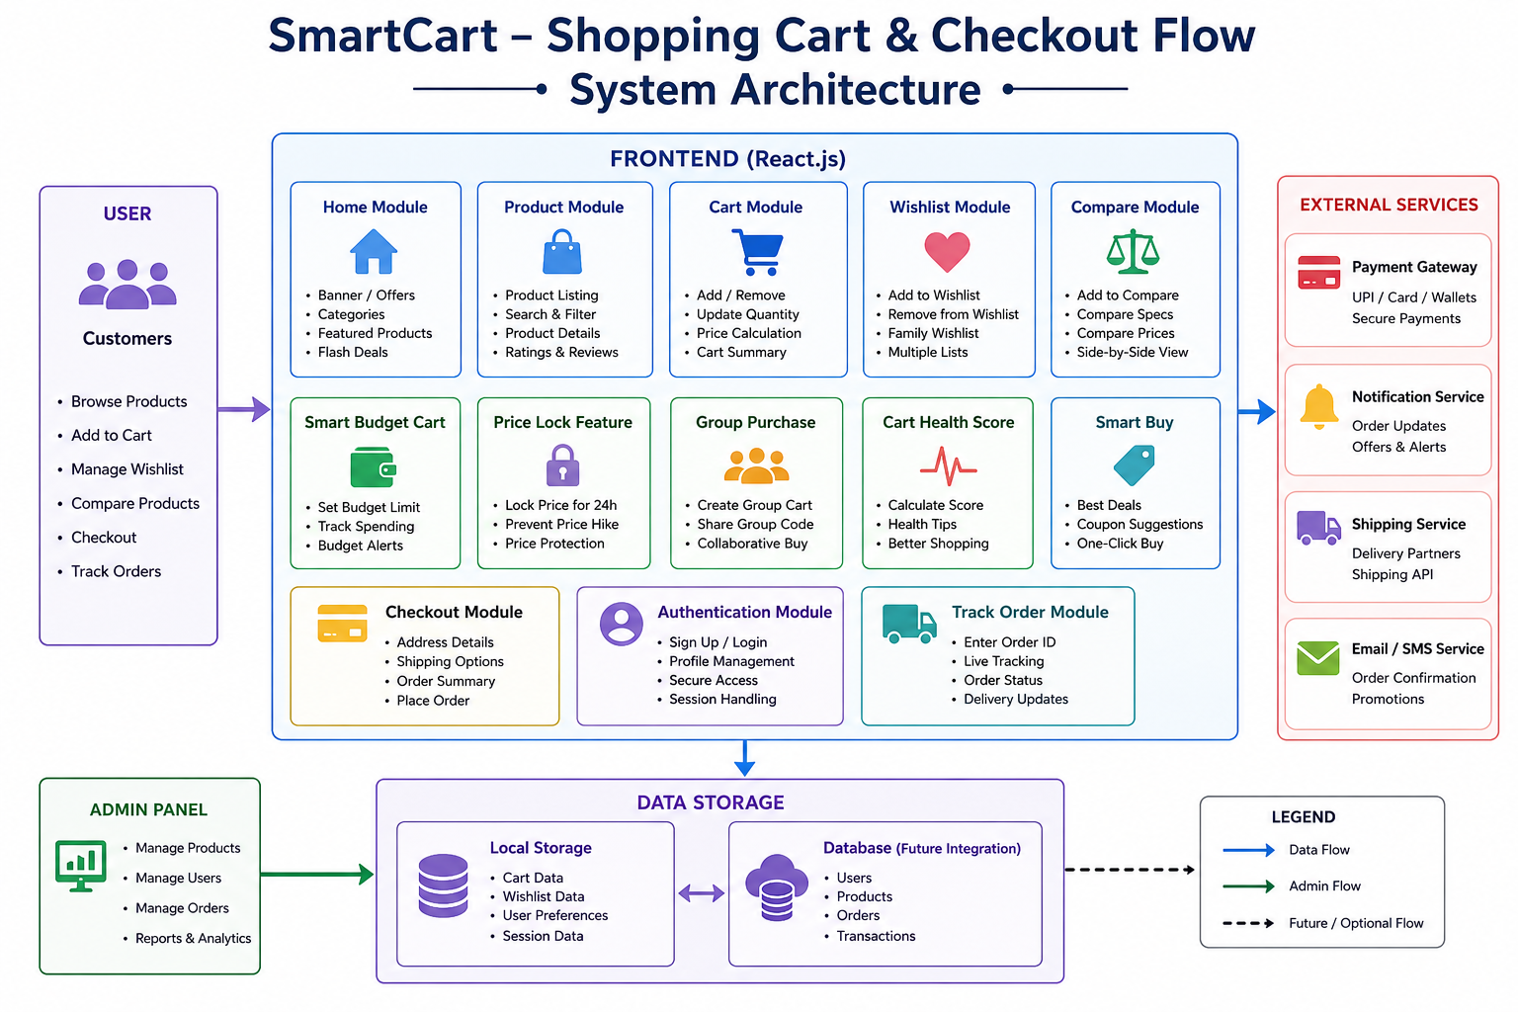

Slide 26
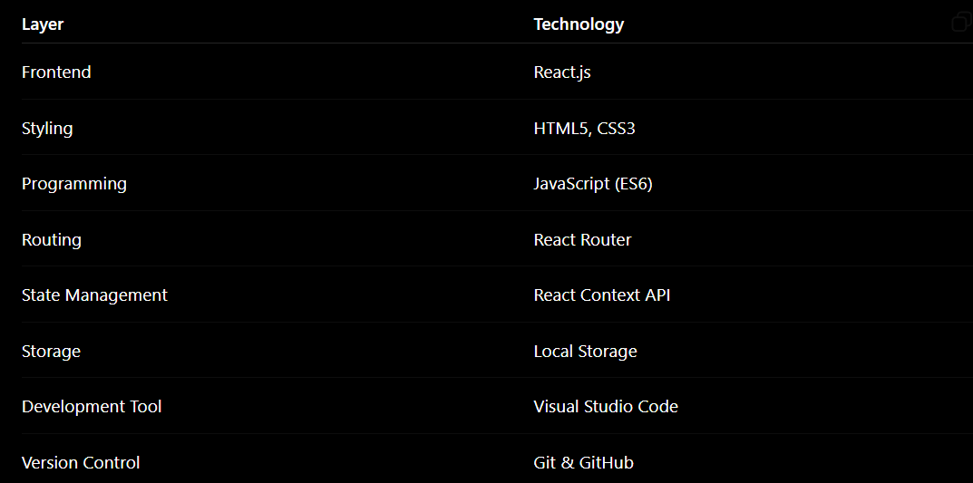
Technologies Used

Slide 27
Advantages of the Architecture
Modular and easy to maintain.
Reusable React components.
Fast and responsive user interface.
Easy integration with backend services.
Scalable for future enhancements.
Improved code organization.
Better performance and user experience.
Supports additional features like payment gateways and AI recommendations

Slide 28
CHAPTER 7: CONCLUSION AND FUTURE SCOPE
The SmartCart – Shopping Cart and Checkout Flow project was successfully designed and developed to provide a modern, intelligent, and user-friendly online shopping experience. The application simplifies the shopping process by combining traditional e-commerce functionalities with innovative features that improve customer convenience and decision-making.
The system enables users to browse products, manage their shopping cart, compare products, save items in wishlists, track orders, and complete purchases through a smooth checkout process. In addition, advanced features such as Smart Budget Cart, Group Purchase Cart, Price Lock, Family Wishlist, Cart Health Score, Flash Deals, and Smart Buy Recommendations enhance the overall shopping experience and distinguish the application from conventional online shopping platforms

Slide 29
The project was implemented using React.js, HTML5, CSS3, and JavaScript, resulting in a responsive, interactive, and visually appealing web application. The modular design improves maintainability and scalability, allowing future enhancements with minimal effort.
Overall, the project achieves its objectives by providing a secure, efficient, and feature-rich shopping platform that improves customer satisfaction, reduces cart abandonment, and promotes smarter purchasing decisions.

Slide 30
7.1 Future Scope
The SmartCart application can be further enhanced with several advanced features, including:
Integration with secure online payment gateways such as UPI, PayPal, and Stripe.
AI-based personalized product recommendations using customer purchase history.
Voice-assisted shopping using speech recognition.
Barcode and QR code scanning for faster product search.
Live inventory management with real-time stock updates.
AI chatbot for customer support.
Order cancellation and return management.

Slide 31
7.2 Advantages
The SmartCart system offers the following advantages:
User-friendly and intuitive interface.
Responsive design for desktop, tablet, and mobile devices.
Faster and smoother checkout process.
Budget management to prevent overspending.
Price Lock feature to protect customers from sudden price changes.
Product comparison for informed purchasing decisions.
Family Wishlist for collaborative shopping.
Group Purchase Cart for shared purchases.

Slide 32
7.3 Limitations
Although the project achieves its objectives, it has a few limitations:
No real payment gateway integration.
Limited to frontend implementation (unless backend is integrated).
Product data is stored locally or in a demo database.
AI recommendations are based on predefined logic.
No real-time inventory synchronization.
Limited admin functionalities.
Does not support international shipping or currency conversion.
These limitations can be addressed in future versions of the project.

Slide 33
7.4 Learning Outcomes
During the development of this project, the following skills and concepts were learned:
React.js component-based development.
HTML5 and CSS3 for responsive web design.
JavaScript for interactive functionality.
State management using React Context API.
Routing using React Router.
Local Storage for data persistence.
UI/UX design principles.
Modular software development.
Testing and debugging techniques.
Project documentation and report preparation.

Slide 34
7.5 References
React.js Official Documentation – https://react.dev/
MDN Web Docs – https://developer.mozilla.org/
JavaScript.info – https://javascript.info/
W3Schools – https://www.w3schools.com/
HTML5 Specification – https://html.spec.whatwg.org/
CSS Documentation – https://developer.mozilla.org/docs/Web/CSS
React Router Documentation – https://reactrouter.com/
Vite Documentation – https://vitejs.dev/
Node.js Documentation – https://nodejs.org/
MongoDB Documentation – https://www.mongodb.com/docs/

Slide 35
Final Summary
The SmartCart – Shopping Cart and Checkout Flow : project successfully demonstrates the development of a modern e-commerce frontend with intelligent shopping features. By integrating innovative functionalities such as Smart Budget Cart, Group Purchase Cart, Price Lock, Family Wishlist, Product Comparison, Flash Deals, Smart Buy Recommendations, and Order Tracking, the application delivers a more efficient, convenient, and personalized shopping experience. The project serves as a strong foundation for building a complete enterprise-level e-commerce platform with advanced AI, payment, and cloud-based capabilities in the future.

